Slide 1
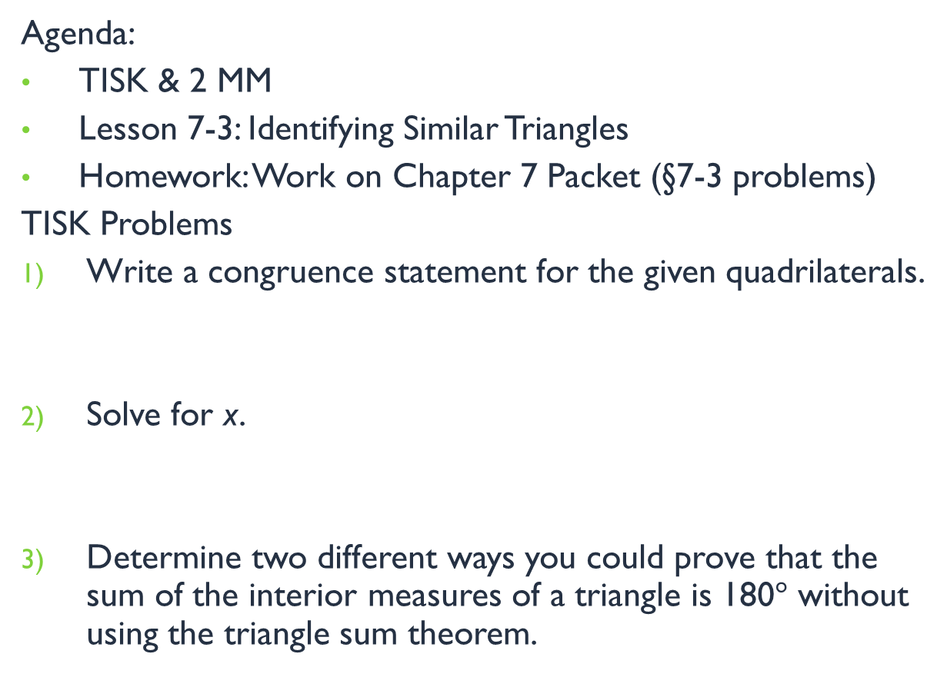


Thursday, January 10, 2013
Agenda:
TISK & 2 MM
Lesson 7-3: Identifying Similar Triangles
Homework: Work on Chapter 7 Packet (§7-3 problems)
TISK Problems
Write a congruence statement for the given quadrilaterals.
Solve for x.
Determine two different ways you could prove that the sum of the interior measures of a triangle is 180$°$ without using the triangle sum theorem.
B
E
C
A
P
H
D
Y
$$\left(3x\right)°$$
$$\left(5x\right)°$$
Notes:
Mental Math
1.) Start with the number of sides in a pentagon. Square it. Multiply by the number of quarters in a dollar. Divide by the number of bases in a trapezoid. Take half. Find the square root. (5)
2.) Start with the number of angles in a heptagon. Square it. Multiply by the number of dimes in a half-dollar. Subtract two. Divide by the number of midsegments in a triangle. Take the square root. Subtract 2. (7)

Slide 2
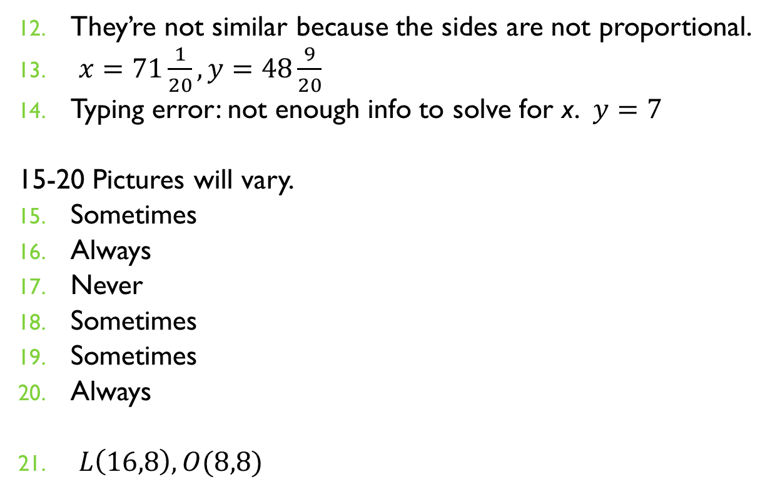
Homework Check
They’re not similar because the sides are not proportional.
$x=71\frac{1}{20}, y=48\frac{9}{20}$
Typing error: not enough info to solve for x. $y=7$
15-20 Pictures will vary.
Sometimes
Always
Never
Sometimes
Sometimes
Always
$L\left(16,8\right), O(8,8)$

Slide 3
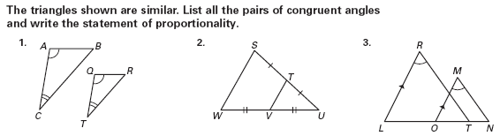
§7.3 Identifying Similar Triangles
The triangles shown are similar. List all pairs of congruent angles and write the statement of proportionality.
Angles
Statement of Proportionality

Slide 4

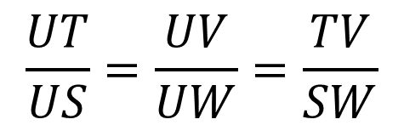


§7.3 Identifying Similar Triangles
The triangles shown are similar. List all pairs of congruent angles and write the statement of proportionality.
Angles
$$∠U≅∠U$$
$$∠UTV≅∠USW$$
$$∠UVT≅∠UWS$$
Statement of Proportionality
$$\frac{UT}{US}=\frac{UV}{UW}=\frac{TV}{SW}$$

Slide 5

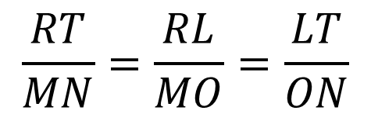


§7.3 Identifying Similar Triangles
The triangles shown are similar. List all pairs of congruent angles and write the statement of proportionality.
Angles
$$∠R≅∠M$$
$$∠L≅∠MOT$$
$$∠RTL≅∠N$$
Statement of Proportionality
$$\frac{RT}{MN}=\frac{RL}{MO}=\frac{LT}{ON}$$

Slide 6
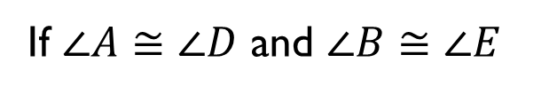

Postulate:
Angle-Angle (AA) Similarity Postulate
If two angles of one triangle are congruent to two angles of another triangle, then the two triangles are similar.
B
E
If $∠A≅∠D$ and $∠B≅∠E$
then $ΔABC\sim ΔDEF$
D
F
A
C
Notes:
9A finished here

Slide 7
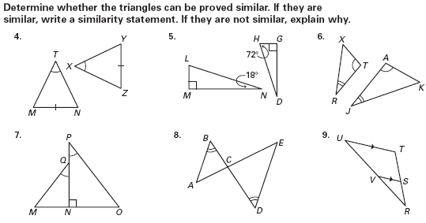
Example.
Decide whether the triangles can be proved similar. If they are similar, write a similarity statement. If they are not similar, explain why.
Not similar.
We are only given an angle (A) and a side of congruence. This is not enough to determine if the triangles are similar.

Slide 8

Example.
Decide whether the triangles can be proved similar. If they are similar, write a similarity statement. If they are not similar, explain why.
Yes, similar
$$ΔLMN\sim ΔHGD$$

Slide 9

Example.
Decide whether the triangles can be proved similar. If they are similar, write a similarity statement. If they are not similar, explain why.
Yes, similar
$$ΔTRX\sim ΔAJK$$

Slide 10
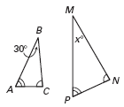
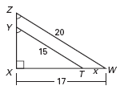

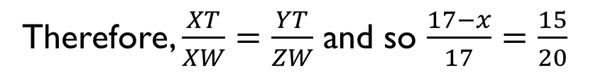
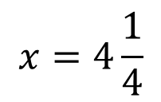



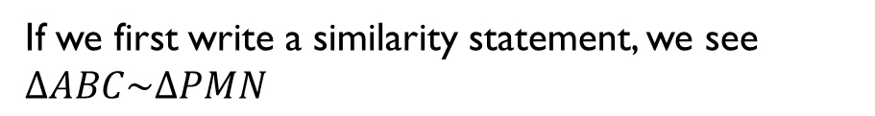
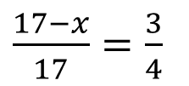
Example. The triangles are similar. Find the value of the variable.
Since they’re similar, they have congruent angles.
If we first write a similarity statement, we see $ΔABC\sim ΔPMN$
Therefore, $∠M≅∠B$ and so
$$x=m∠M=m∠B=30°$$
Since they’re similar, they have proportional sides.
If we first write a similarity statement,
we see $ΔYXT\sim ΔZXW$
Therefore, $\frac{XT}{XW}=\frac{YT}{ZW}$ and so $\frac{17−x}{17}=\frac{15}{20}$
$$68−4x=51$$
$$x=4\frac{1}{4}$$
$\frac{17−x}{17}=\frac{3}{4}$
$$4x=17$$

Slide 11
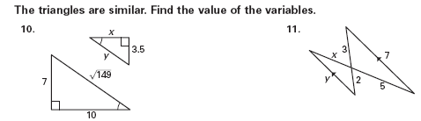
You Try It.
The triangles are similar. Find the value of the variables.
Notes:
9B ended on this slide, but must present solutions

Slide 12
Similarity Theorems
SSS Similarity Theorem
  If the lengths of the corresponding sides of two triangles are proportional, then the triangles are similar.
SAS Similarity Theorem
  If an angle of one triangle is congruent to an angle of a second triangle and the lengths of the sides including these angles are proportional, then the triangles are similar.

Slide 13
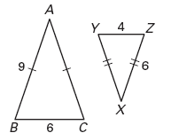

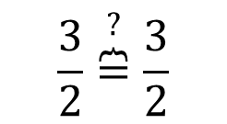
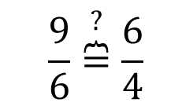
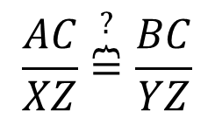
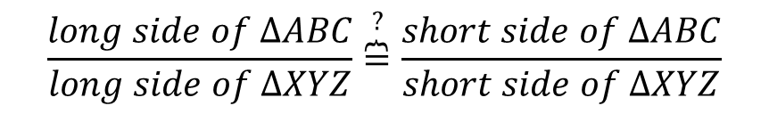


Example. Are the triangles similar? If so, state the similarity and the postulate or theorem that justifies your answer.
No angles are marked as being congruent, so that leaves us with only the SSS theorem to check.
$$\frac{long side of ΔABC}{long side of ΔXYZ}\overset{?}{\overbrace{=}}\frac{short side of ΔABC}{short side of ΔXYZ}$$
$$\frac{AC}{XZ}\overset{?}{\overbrace{=}}\frac{BC}{YZ}$$
$$\frac{9}{6}\overset{?}{\overbrace{=}}\frac{6}{4}$$
$$\frac{3}{2}\overset{?}{\overbrace{=}}\frac{3}{2}$$
$$∴\frac{AC}{XZ}=\frac{BC}{YZ}=\frac{AB}{XY}$$
Yes, $ΔABC\sim ΔXYZ$ by SSS Similarity Theorem

Slide 14
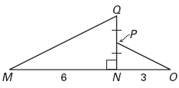
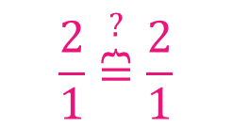
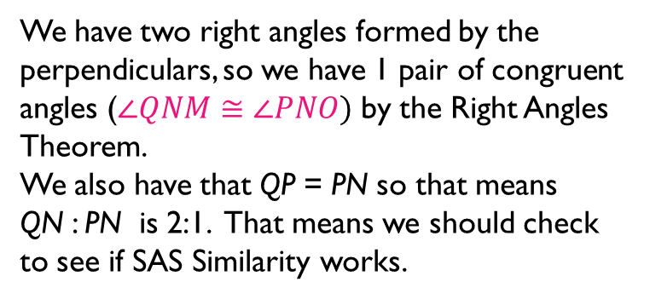
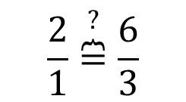
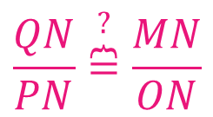

Example. Are the triangles similar? If so, state the similarity and the postulate or theorem that justifies your answer.
We have two right angles formed by the perpendiculars, so we have 1 pair of congruent angles ($∠QNM≅∠PNO)$ by the Right Angles Theorem.
We also have that QP = PN so that means
QN : PN is 2:1. That means we should check to see if SAS Similarity works.
$$\frac{QN}{PN}\overset{?}{\overbrace{=}}\frac{MN}{ON}$$
$$\frac{2}{1}\overset{?}{\overbrace{=}}\frac{6}{3}$$
$$\frac{2}{1}\overset{?}{\overbrace{=}}\frac{2}{1}$$
Yes, $ΔQNM\sim ΔPNO$ by SAS Similarity Theorem

Slide 15
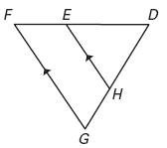
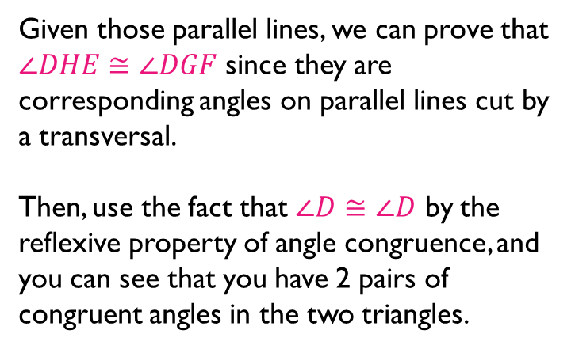
Example. Are the triangles similar? If so, state the similarity and the postulate or theorem that justifies your answer.
Given those parallel lines, we can prove that $∠DHE≅∠DGF$ since they are corresponding angles on parallel lines cut by a transversal.
Then, use the fact that $∠D≅∠D$ by the reflexive property of angle congruence, and you can see that you have 2 pairs of congruent angles in the two triangles.
Yes, $ΔDHE\sim ΔDGF$ by AA Similarity Postulate

Slide 16
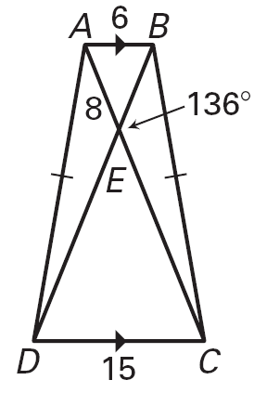











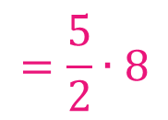


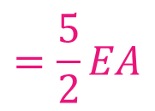
Example. Use the diagram shown to complete the statements.
$$ΔCED$$
$$m∠BEA$$
$$=44°$$
$$m∠EDC$$
$$=68°$$
$$\frac{15}{6}EA$$
$$=\frac{5}{2}EA$$
$$=\frac{5}{2}∙8$$
$$=20$$
$$15:6$$
$$=5:2$$

Slide 17
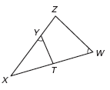
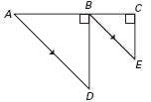

Yes, there are 2 proofs on your homework.
Remember a few things…
  There are often shared pieces when triangles overlap.
  Take nothing for granted.
Here, $∠X$ is in both $ΔXYT$ and $ΔXZW$
State that you have right angles.
State that they are then congruent.
That’s TWO STATEMENTS.

